Slide 1
FANTASY FOOTBALL ANALYTICS AND PREDICTOR
Notes:
Fantasy football is a game that allows you to be the owner, GM, and coach of your very own football team. Competing against your friends, you draft a team made up of NFL players and based on their on-field performance in a given week, you score points. Add up all the points and ,just like real life, the team with the most at the end of the NFL week is the winner for that week. You essentially have a record, play for the playoffs and if you finish in the top 3 or in the case of daily fantasy the top percentile you take home the cash, which varies greatly among different leagues as each league will have they're own buy in.
We wanted to see if we could transform NFL data sources and statistics, engineer features for machine learning, create data frames and a database to try predict and "cheat" the draft all in an effort to look for potential "sleepers" in our home leagues or daily fantasy drafts to find maximum value of players at minimal draft costs. This is our NFL Fantasy AI Predictor.

Slide 2
Fantasy At A Glance
$18.6 Billion
47 Million
Fantasy Footballs Yearly Market: Which is 6X more than the NFLs current revenue and 4.5X more than the Dallas Cowboys value.
Fantasy Football Players in the United States Yearly.
Notes:
Fantasy football is 18.6 Billion dollar yearly industry with both season long and daily fantasy options. The yearly market itself produces 6X more than the total of the NFLs current revenue and makes 4.5X more than the Dallas Cowboys complete value.

Slide 3
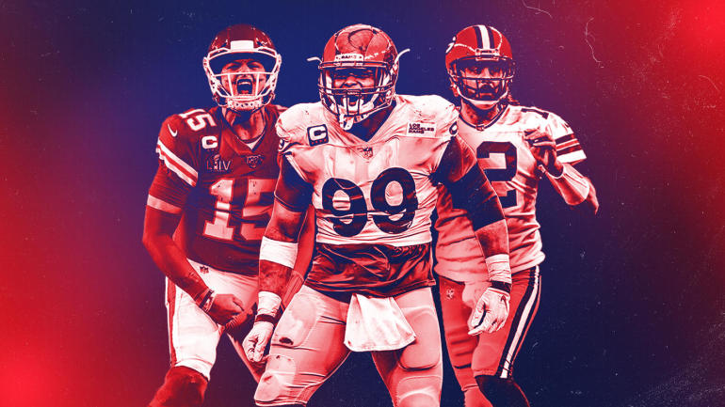
Fantasy Football Rosters
1 QB | Quarterback
2 RBs | Running Back(s)
2 WRs | Wide Receiver(s)
1 TE | Tight End
1 FLEX | WR, RB, TE
I DEF | Defense
1 K | Kicker
Notes:
A team consists of 9 starters in 7 positions. The 7 positions are quarterback (QB), running back (RB), wide receiver (WR), tight end (TE), kicker(K) and team defense (DF). We wanted to see if we could transform data sources and NFL statistics, engineer features for machine learning, create data frames and a database to try predict and "cheat" the draft all in an effort to look for potential "sleepers" in our home leagues or daily fantasy drafts to find maximum value of players at minimal draft costs.

Slide 4
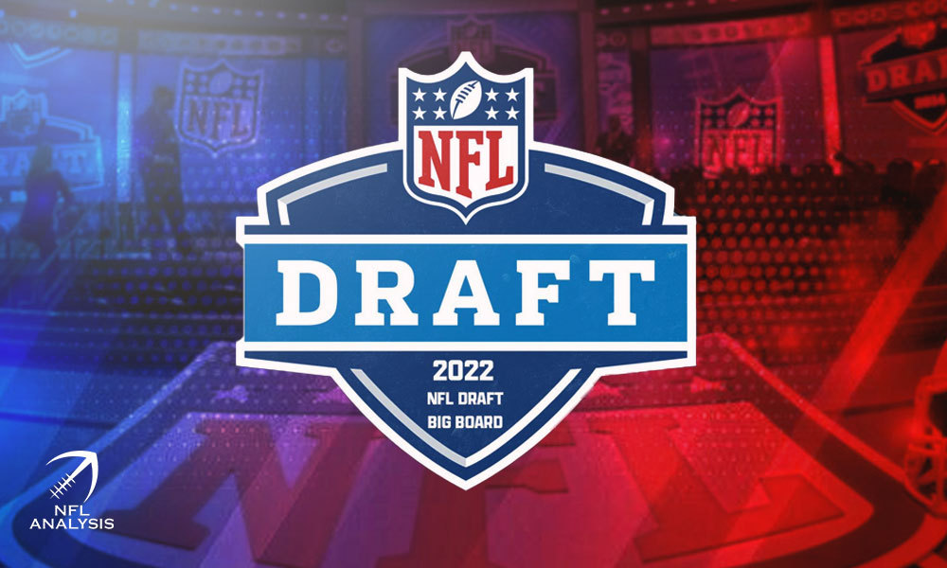
Nailing The Fantasy Football Draft
Draft Order & Team Numbers
Rounds and Determining Value
Standard, PPR, Half PPR
Draft Strategies
ADP or Average Draft Position
League Winners
Sleepers (Maximum Value for low cost)
Cheat The Draft and Leverage Stats to Determine Value
Notes:
There are multiple rounds in each draft. A drafting order is predetermined or randomly selected. Each team takes turns picking players for his or her roster. If there are 12 owners in your league, the team picking last in the first round would have the first pick in the second round (1 to 12, 12 to 1, 1 to 12, etc).
Theres a variety of different scoring methods suffice to say the 3 most popular were covered here. Theres:
1. Standard:
25 passing yards: 1 point Passing touchdown: 4 points 10 rushing or receiving yards: 1 point Rushing or receiving touchdown: 6 points Interception or lost fumble: -2 points
PPR & Half PPR:
Same as standard scoring, however one reception earns one point or ½ earns you .5 points. These leagues make receivers, tight ends and pass-catching running backs much more valuable. There are also half-PPR leagues that award 0.5 points per catch.
ADP: Average draft position (ADP) is an informative tool for gaining general understanding of how fantasy football owners currently view players. Quality ADP data providers painstakingly calculate the results by weeding out computer selections and wild outliers.
Sleepers and League Winners are those players that go overlooked and will out perform his ADP season long.

Slide 5
NFL Stats Player Profile
Positional Rankings in ADP
Position Breakdown
98%
2%
Interests and Features
Machine Learning Models
14%
38%
28%
20%
QBs/Skill Positions
Defense /Kickers
QBs
WRs
RBs
TEs
30%
60%
10%
Production
Usage
TotalYdScrm
Keras
Logistic Regression
Clusters
Notes:
Because WR, RBs, and TEs rank higher in ADP, score the most amount of fantasy points, and comprise the majority of players chosen in a given draft, the emphasis and interests we chose to find ‘sleepers’ were skill positions primarily, quarterbacks secondarily, and lastly rookies in all positions.
This is a rough breakdown of what the statistics are on a fantasy draft as well as some of our features we engineered i.e. for Running Backs
We determined:
Production: defined as all receiving yards + rec tds + rushing yards + rushing tds, / Usage
Where:
Usage is : Targets + Rushing Atts / Number of Games Played
Lastly
TotYrdsScrm: Receving Yards + Rushing yards

Slide 6
OPERATING TABLE OF CONTENTS
01
02
03
Data Processing
Machine Learning
Predictions
Data munging and transformation
Unsupervised and Supervised
& Algorithms
Players by Round and
Website Demo

Slide 7
01
Data Processing

Slide 8
Data Munging and Transformation
Data
Feature Engineering
Average Draft Position
Pro-Football Reference for Veterans and Web-Scraping for Rookies
Creating Target Features and ensuring players are eligible for drafting in 2022
FantasyPros and connecting dataframes

Slide 9

PROJECT METHODS AND LANGUAGES
PYTHON
PANDAS/Jupyter
SQL AWS RDS
FLASK & API
Sklearn, Keras,
Logistical
Regression
AWS, RDS via
SQL or PostGres
Data Cleaning Jupyter/Python
NFL Data from
2019, 2020, 2021
CSV
01
02
03
04
Machine Learning
Heroku Web code
Index.js, Javascript
Functions make request to API per user
Flask (Python) API
Interface Backend
Data with Model
Logic
07
06
05
Heroku
Javascript
Notes:
Pythong -> pandas > machine learning > rds > flask > js > heroku

Slide 10
02
Machine Learning
Predicting How Well Players Will Do
Notes:
As Ronnie Stated our goal is to predict “sleepers”, those players who have potential for big Fantasy Scores but are overlooked by the current models. Since, we are providing suggested draft order for the entire fantasy squad this had to be balanced with “conventional wisdom”, we had to make sure that in our efforts to predict “sleepers” that favored candidates still appeared in draft locations that insured a winning fantasy team.

Slide 11
Machine Learning
Database
Data Collection
Evaluating Models
CSVs are sent to AWS RDS SQL database
Writing scripts and features that produce target features
Data sent to algorithm that makes the predictions
Notes:
Evaluating models – we looked at a wide range of models in each of the disciplines. We looked at unsupervised learning and while our data did lend itself to clustering, which you will see in a later slide. We also looked at deep-learning models. We ran our largest dataset though 179 Keras turner trials. However, the deep learning models suffered to produce good results. We chose to concentrate on supervised learning models to achieve our prediction results.

Slide 12
Machine Learning
Predictions
Functions and Scalars
Testing and Training
Scaling data, fitting model, dimensionality reduction
Players, ADP, and Sleepers who will perform well in 2022
Reshaping, Splitting the data, Classifiers
Notes:
We tested our data against 9 algorithms, with 6 scalers. We ran each of our 4 sets of data independent of each other. Not all datasets performed equally with each model. Each data set has it own saved ML model.

Slide 13
Choosing The Right Model
Unsupervised
Supervised
Neural Networks
KNN
Predictions
Accuarcy
Algorithms clusters unlabled datasets
Labeled datasets train algorithms to classify and predict
Uses Proximity to make classifications
Series of algorithms trys to recognize underlying relationships
Output of an algorithm after being trained
Which model was the most accurate and precise
Notes:
In total we ran our largest dataset through over 450 models. In the end linear regression and extra trees regressions produced the best results respective to their input datasets.

Slide 14
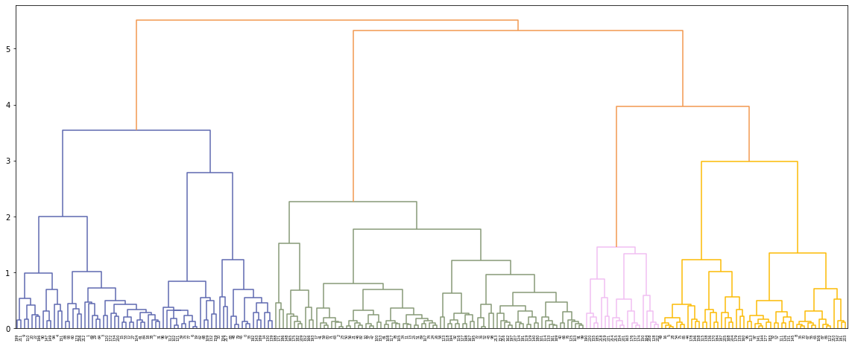
Skill Players Clusters by Position
Notes:
While our data did form the expected clusters by skill position – the models were unable to produce the ranked results we were looking to get.

Slide 15
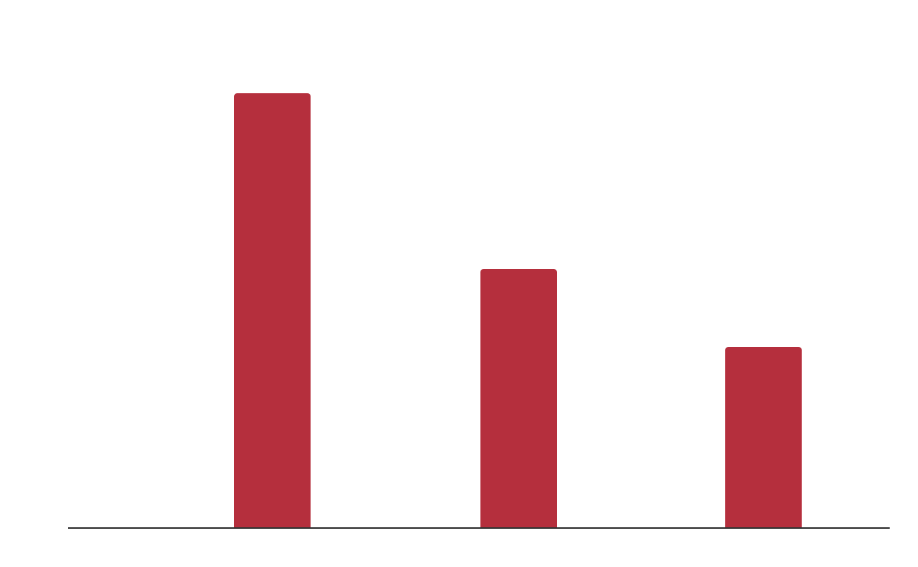
OUR MACHINE LEARNING RESULTS
Rookies Model
Main Model
96.7%
99.4%
QB
TE, WR, RB
Rookies
Testing
Training
Prediction Accuracy
Notes:
After establishing some effective models – we focused on creating features and standardizing input features to produce our desired rankings. The wizardry really did happen in this step, If you are interested in seeing how we calculated our magic features by all means check it out in the NFL_Fantasy_improve _Target_woQB notebook. We were able to verify our magic, by watching a specific player we predicted should be higher in the draft order – move up in the draft order during the few days we had to monitor changes! Yay magic.

Slide 16
03
PREDICTIONS
Website Demo and Predictions

Slide 17
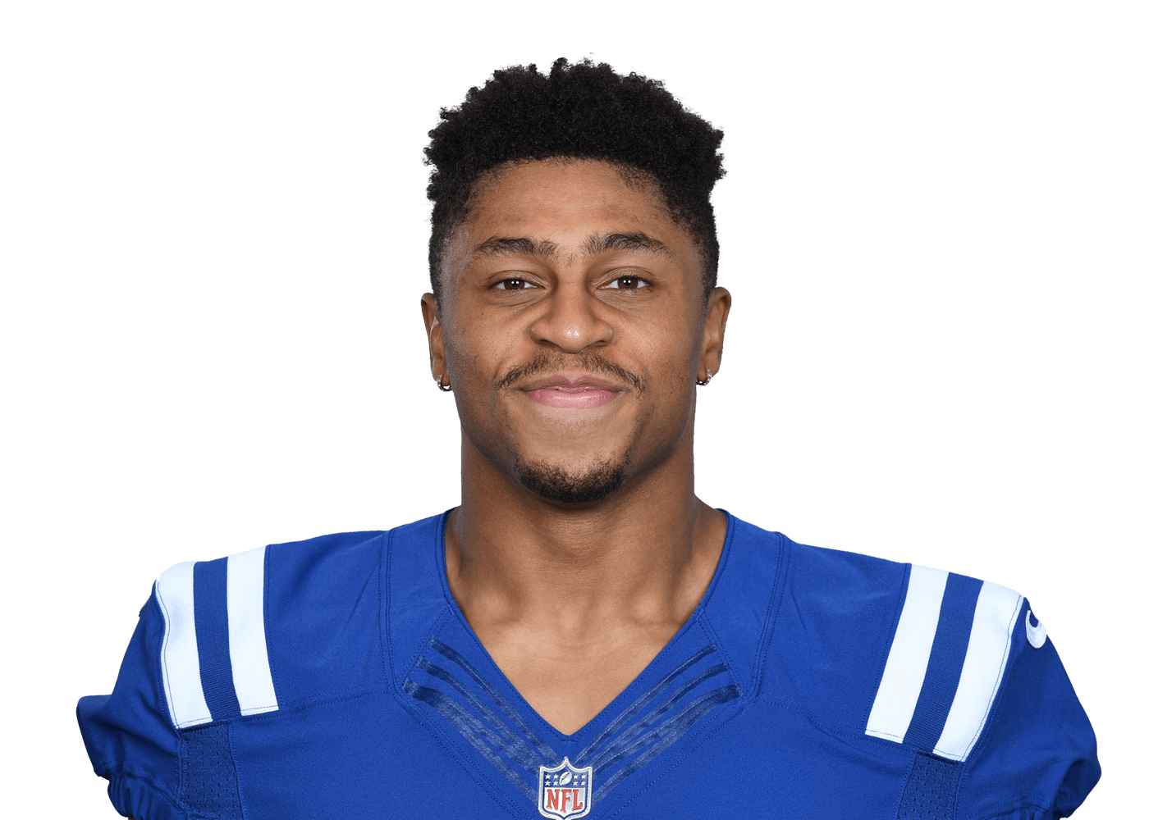
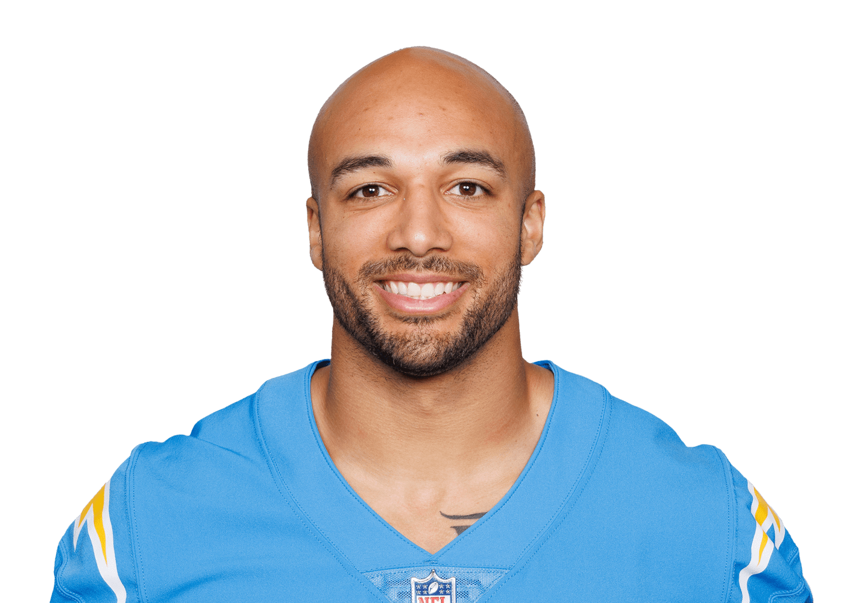
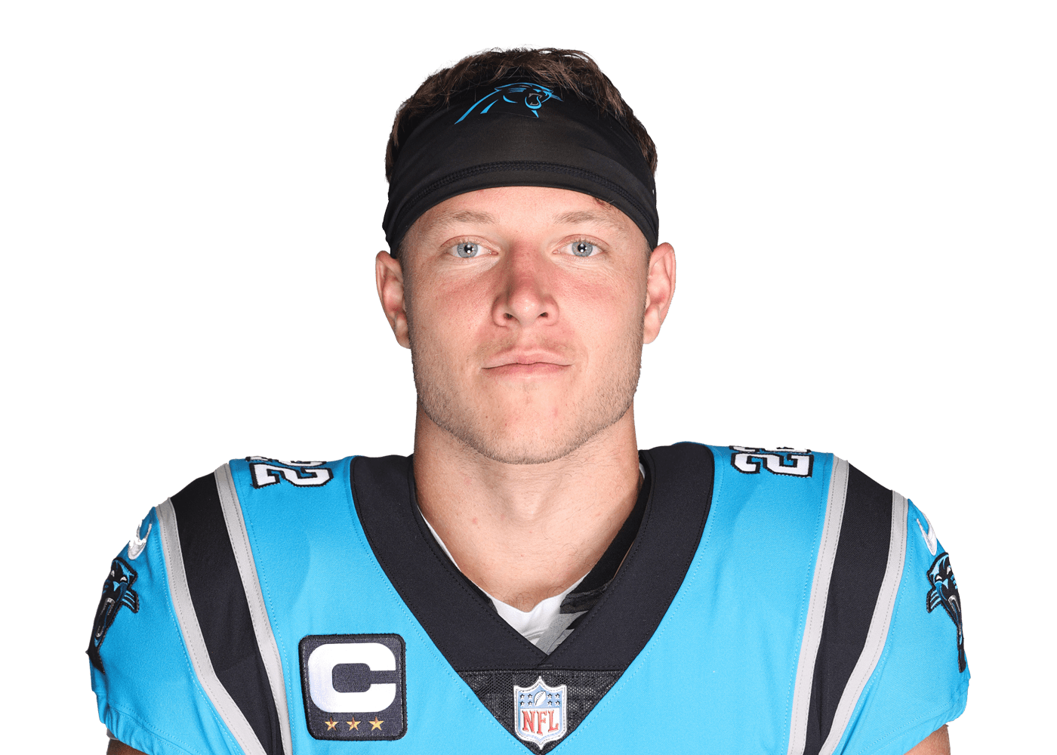
AWARDS
Jonathan Taylor
Austin Ekeler
Christian McCaffery
RB1 according to all models.
RB2 according to all models.
RB3 according to all models.
2
3

Slide 18
OUR CHALLENGES A GAME OF INCHES
Reliable Sources
Combining The Data
Predicting the Future
Quality Product
Completing Database
Creating Working Model
Training the Algorithm
Lots of Moving Parts
Few sources as possible, to ensure continuity.
Web-Scraping Rookies
Making Learning Algorithm
Creating the Website
Search for NFL Players
View Statistics
Machine Based Predictions
Reliable Results
Functionality
Sortable by Player, Rounds, and ADP

Slide 19
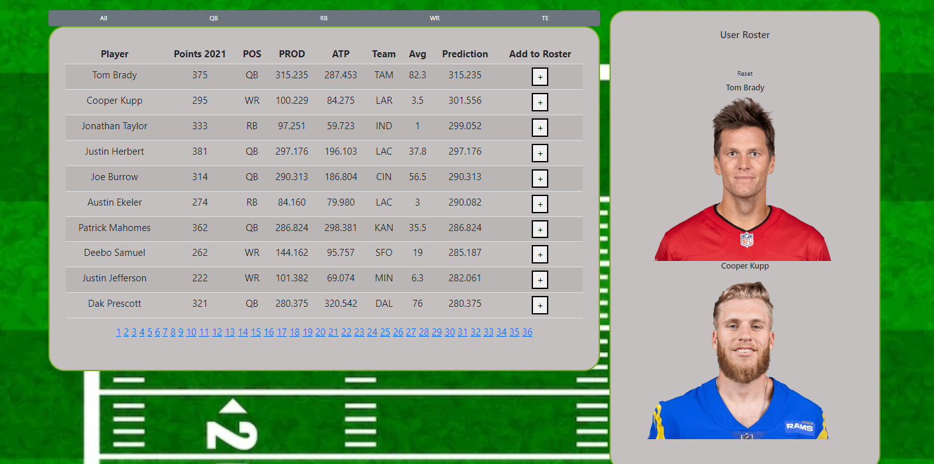
OUR NFL FantasyAI Assistant

Slide 20
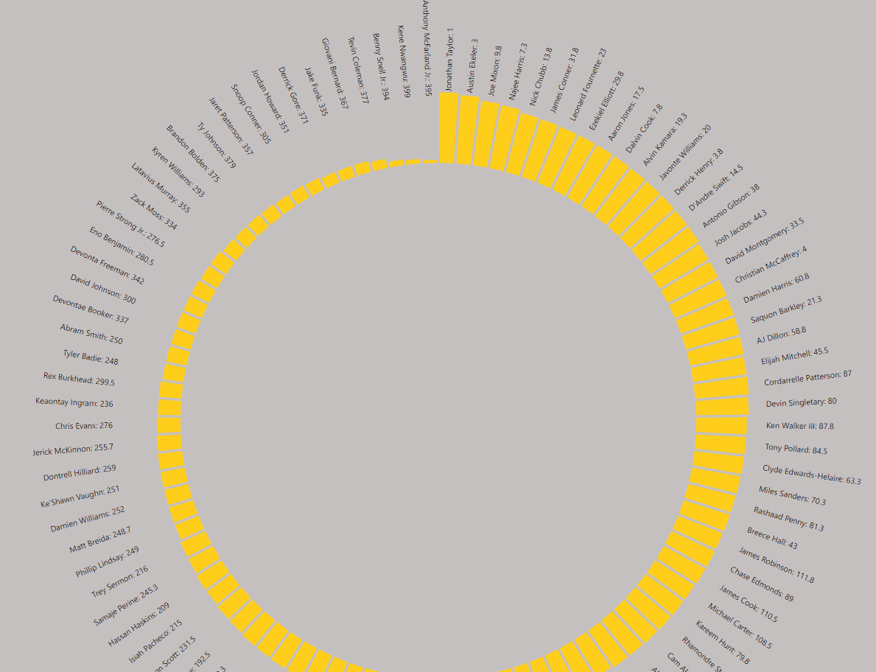
PREDICTIONS WHEEL
03

Slide 21
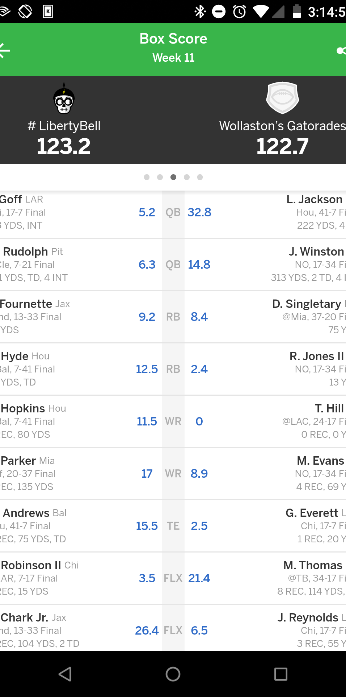
OUR NFL FantasyAI Website
Go check out Who You Should Draft @ https://fantasy-football-ai-assistant.herokuapp.com/

Slide 22
NFL PREDICTIVES RESOURCES
NFL DATA & APIs
Pro-Football Reference
FantasyPros ADP
FantasyPros Rookies
Machine Learning
Sklearn
TensorFlow
Keras

Slide 23
THANKS!
Do you have any questions?
Ronnie Phillips
Lynne Freilich
Jesse Perez
Yi Huang

Slide 24
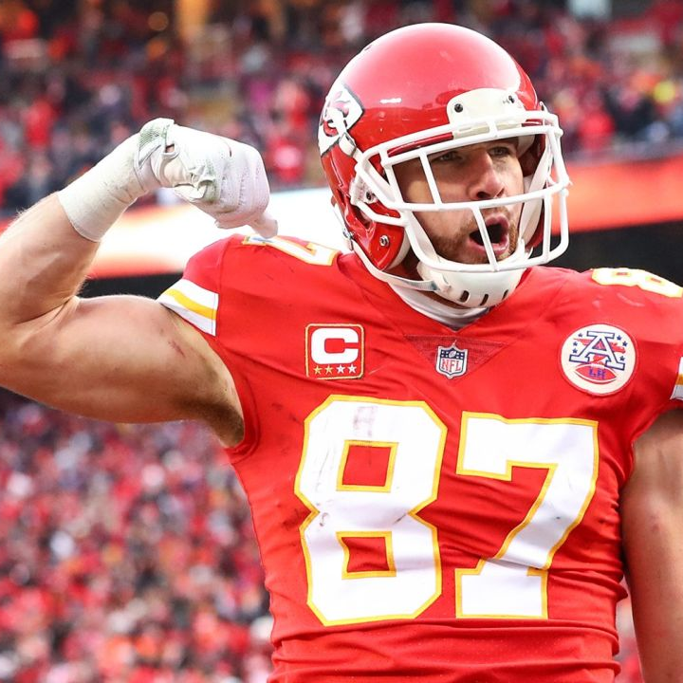
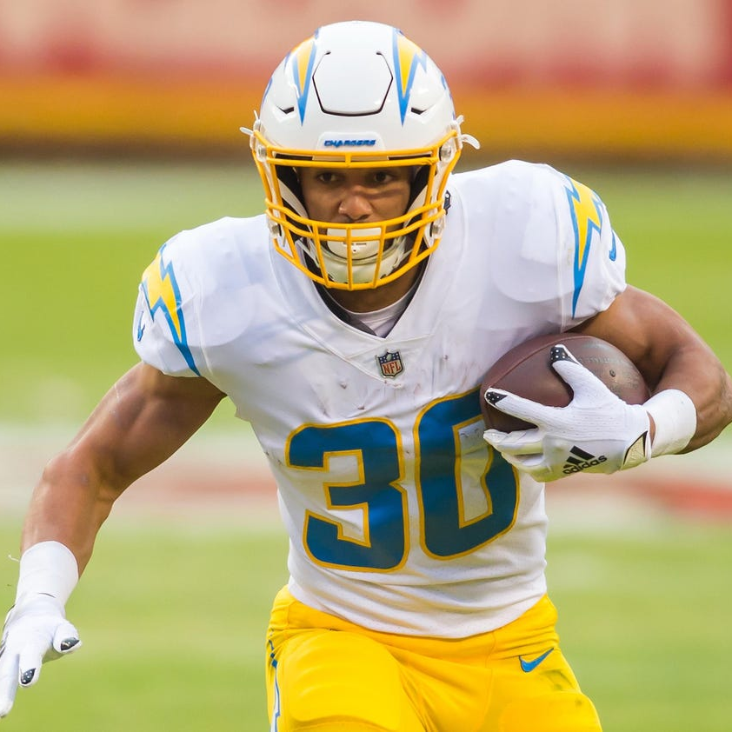
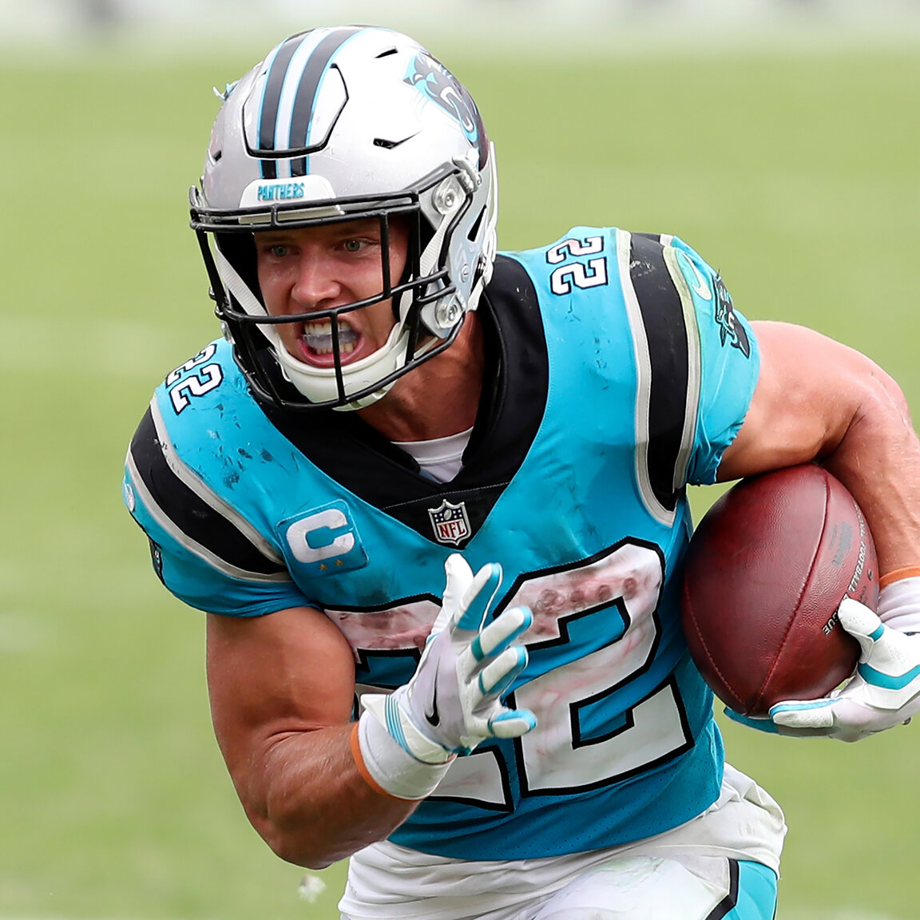
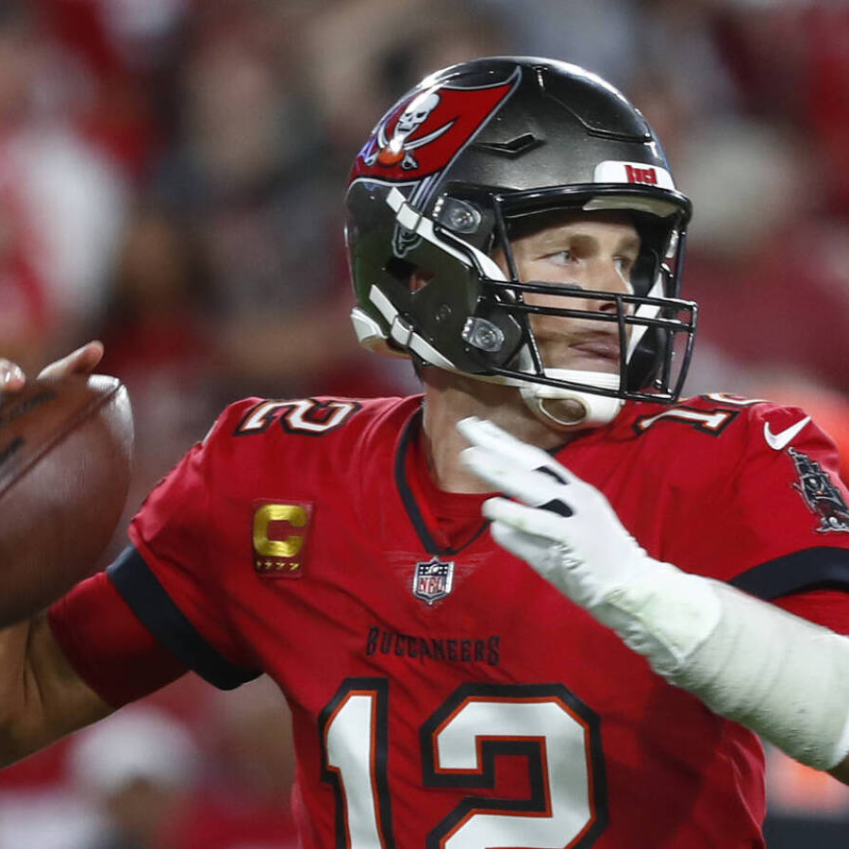
OUR TEAM
Ronnie Phillips
Jesse Perez
Lynne Freilich
Yi Huang

